Slide 1
Employee Data Analysis using Excel
STUDENT NAME: AIYSHA NOUSHEEN. S
REGISTER NO: 312209815
NM ID: 7BCEAC32AED62C28B664A528A63A15AD
DEPARTMENT: B.COM (ACCOUNTING AND FINANCE
COLLEGE: VALLIYAMMAL COLLEGE FOR WOMEN

Slide 2
PROJECT TITLE
Employee Performance Analysis using Excel

Slide 3


AGENDA
Problem Statement
Project Overview
End Users
Our Solution and Proposition
Dataset Description
Modelling Approach
Results and Discussion
Conclusion
3/21/2024 Annual Review

Slide 4

PROBLEM STATEMENT
EMPLOYMENT PERFORMANCE ANALYSIS is done in the organisation
for his or her increment.
to track performance.
to focus on the growth of the organisation.
to motivate the employee to have effectiveness.

Slide 5

PROJECT OVERVIEW
EMPLOYEE DATA ANALYSIS:
Using data to understand employee behavior, performance, and trends, making informed HR decisions to improve workplace culture, retention, and productivity.

Slide 6

WHO ARE THE END USERS?
END-USERS OF EMPLOYMENT DATA ANALYSIS:
Managers: For talent management, employee engagement, and retention strategies. Business Leaders: To inform strategic decisions, optimize workforce, and drive business outcomes. Recruiters: To improve recruitment processes, source top talent, and reduce time-to-hire. Talent Development Teams: To design training programs, identify skill gaps, and enhance employee growth. Compensation and Benefits Teams: To determine fair pay, benefits, and rewards structures. Diversity, Equity, and Inclusion (DEI) Teams: To monitor diversity metrics, identify biases, and promote inclusive workplaces.

Slide 7

OUR SOLUTION AND ITS VALUE PROPOSITION
FILTERING – Remove Missing Values
CONDITIONAL FORMATTING – Blank
FORMULA –Performance
PIVOT TABLE - SUMMARY
GRAPH – Data Visualisation

Slide 8
Dataset Description
Employee data set – kaggle
26 – features
9 – features
Employee id – number
First name – text
Last name – text
Employment type
Performance
Gender – male / female
Employment rating – number
Current employee – Number
Business unit – text

Slide 9

THE "WOW" IN OUR SOLUTION
PERFORMANCE LEVEL :
=IFS(Z8>=5, “Very High”,Z8>=4, “High”,Z8>=3, “Medium”, TRUE, “Low”)
3/21/2024 Annual Review
9

Slide 10
MODELLING
DATASET : EMPLOYMENT DATA
FEATURE SELECTION:
EMPLOYEE ID, BUSINESS UNIT, GENDER, PERFORMANCE SCORE, EMPLOYEE TYPE.
DATA CLEANING:
PERFORMANCE LEVEL COMPUTATION USING FORMULA:
=IFS(Z8>=5, "Very High",Z8>=4, "High",Z8>=3, "Medium", TRUE, "Low")
PERFORMANCE SUMMARY PIVOT TABLE
BUSINESS UNIT – ROWS
GENDER-FILTER
GRAPH-BAR CHART FOR EMPLOYEE
10

Slide 11
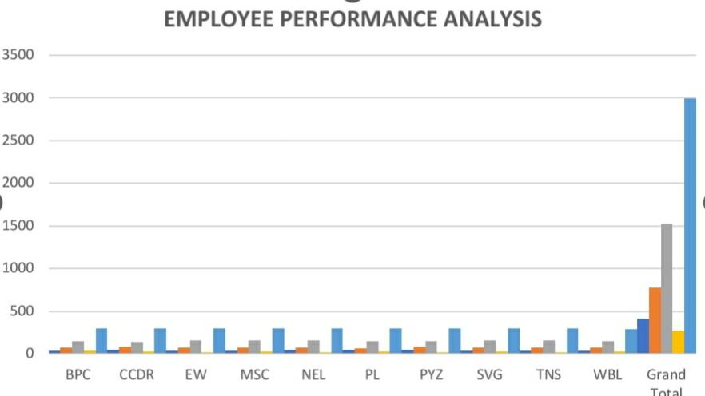
RESULTS
11

Slide 12
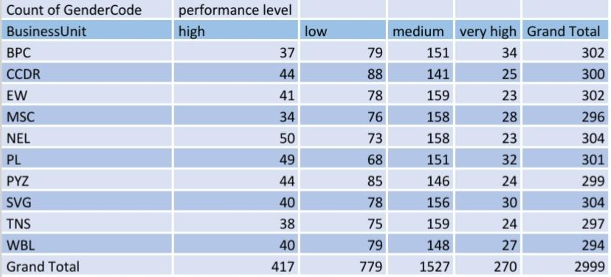

Slide 13
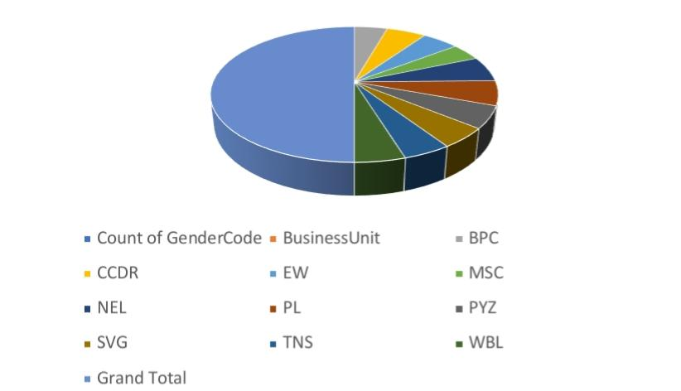

Slide 14
conclusion
Employment data analysis is a powerful tool for organizations to gain insights into their workforce, inform strategic decisions, and drive business success. By leveraging data-driven insights, organizations can optimize talent acquisition, improve employee engagement, and retention, and ultimately, boost productivity and competitiveness.

